Slide 1

VTS677 Product Launch
POVEH
Aug.2022
Product Value Message

Slide 2
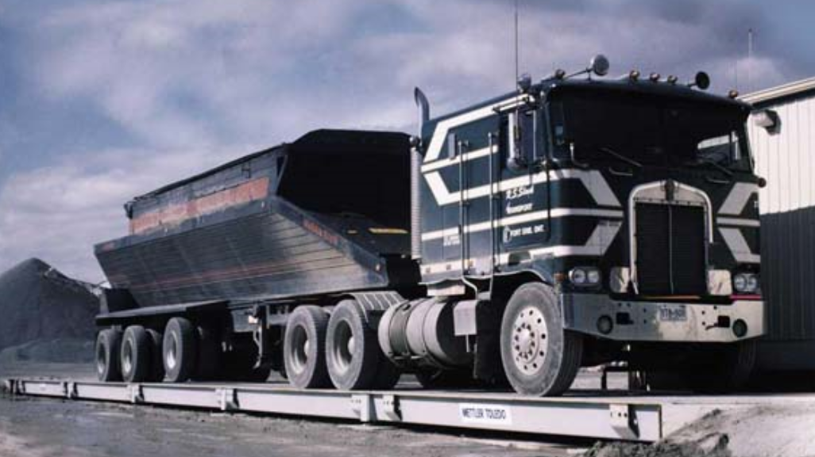
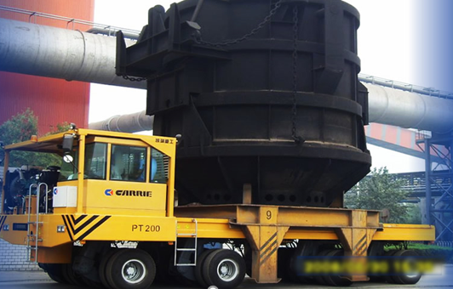
Product Background
Who do we target and why?
Target market:
  Industry Mining and Metal segment
  Workplace/s inbound and out bound, process weighing for the ironladlecar
What pain points does this customer have?
  Mining segment is booming in the developing countries
  No solution for heavy CLC application in mining segment
  No truck scale can match this truck with super long size
  Safety concern for normal truck scale solution in mining and metal segment

Slide 3
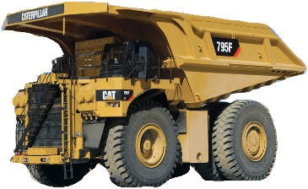
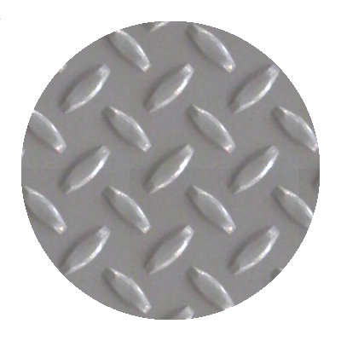
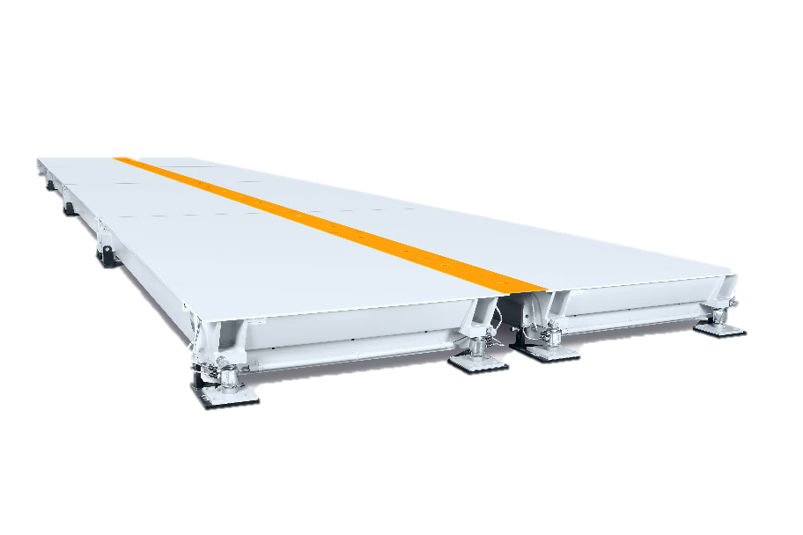
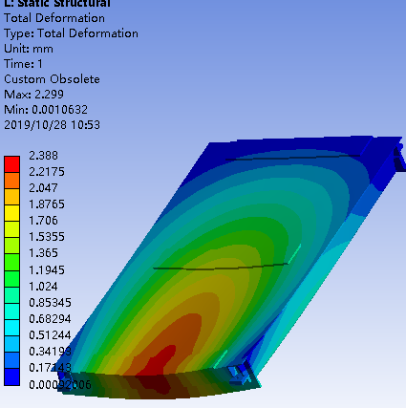
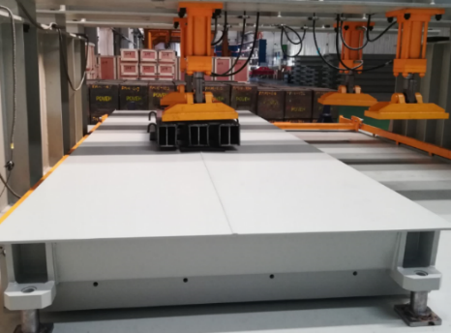
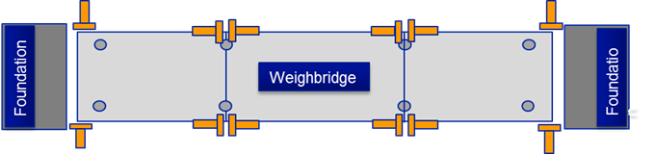
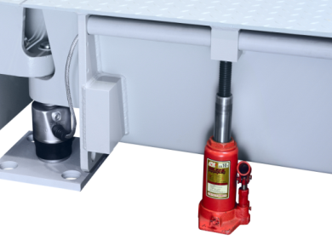
Overview of Product Idea
VTS677 side by side truck scale
Tread plate appearance
Heavy CLC
High frequency Big size
  FEA modular design
Fatigue test
Free maintenance checking system
Jack support
3
Notes:
From the appearance, the VTS677 is made up of two paralleled small scales, with a 300mm gap in the middle
Compared with VTS202 or VTS200, the VTS677 got doubled load cells.
there are some specific features and benefits here: tread plate, special jack support design,
high capacity design and big size for special trucks in high frequency application,
The strong enough module based on the FEA design and the fatigue test

Slide 4
Features, Advantages, Benefits Matrix
Feature | Advantages | Benefits
Side by side structure | Heavy CLC and big size | Match for mining trucks
Mid-bumper design | Anti expansion shrinkage distance | Free bumper maintenance
Tailor design for ultra-width vehicle | Greater margin of safety for driving | Safety for autonomous driving application in
Free assemble modules | Easy for installation | Short installation time
Notes:
Features – Advantages – Benefits Matrix
Use this matrix to summarize only the most critical product features included in this release. Show how each feature supports a product advantage and primary benefit to the user. The matrix challenges the product team to avoid feature bloat, while confirming and reaffirming the relevant benefits to the user. Note that multiple features may be linked to a single advantage, and multiple advantages may be linked to a single benefit.
Don’t forget here to incorporate services and applications as “features”!

Slide 5
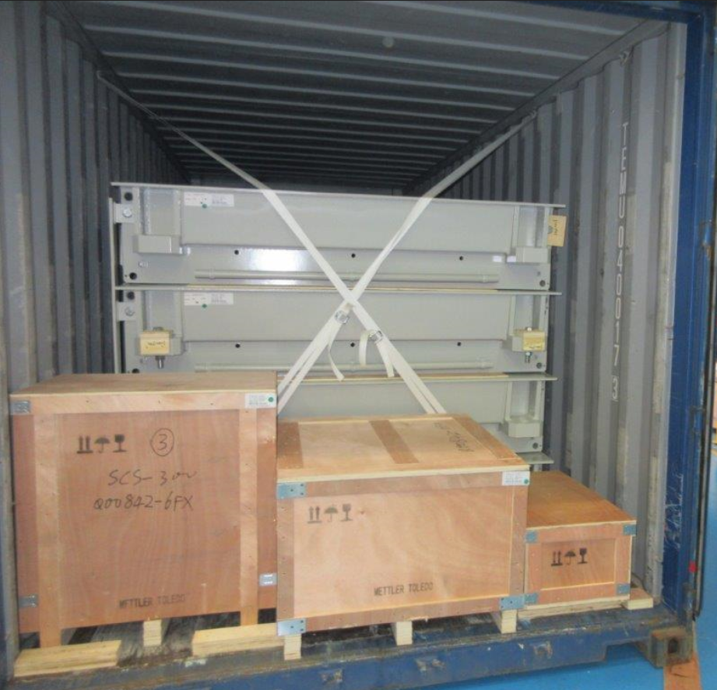
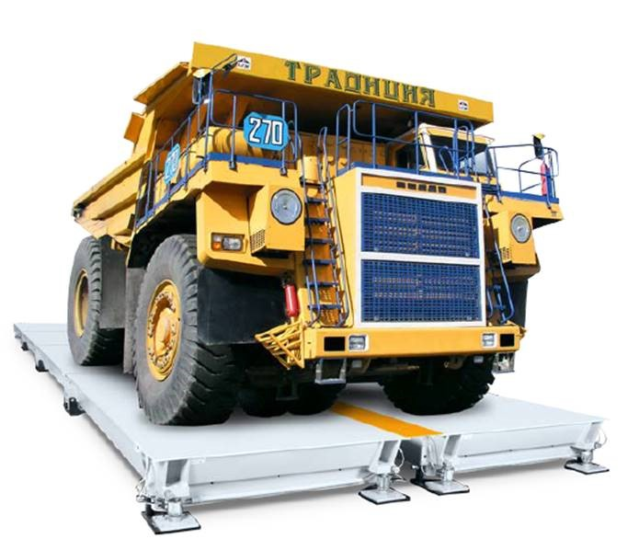
Value Proposition #1
Feature: Side by side structure
Advantage: Heavy CLC and big size
Benefit: Match for mining trucks like Caterpillar, Komatsu etc. and container ready design.
Value Proposition: Accurate and safe weighing for mining application
Value Message: Robust but accurate

Slide 6
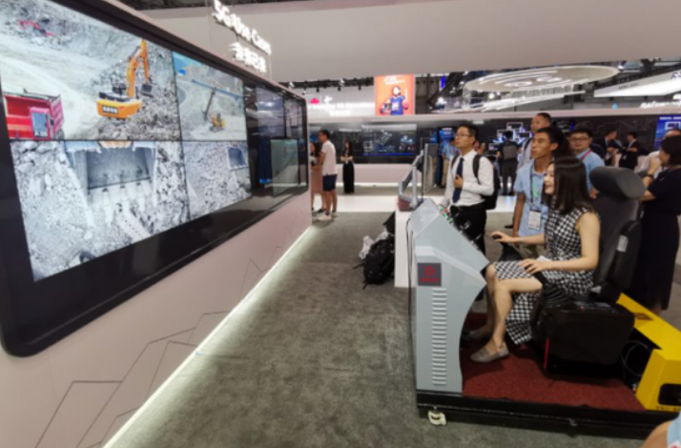
Value Proposition #2
Feature: Tailor design for ultra-width vehicle
Advantage: Greater margin of safety for driving
Benefit: Safety for autonomous driving application in
Value Proposition: Autonomous driving driven by intelligent mining brings a need for ultra-wide truck scale for the safety concern.
Value Message: Double Safety

Slide 7
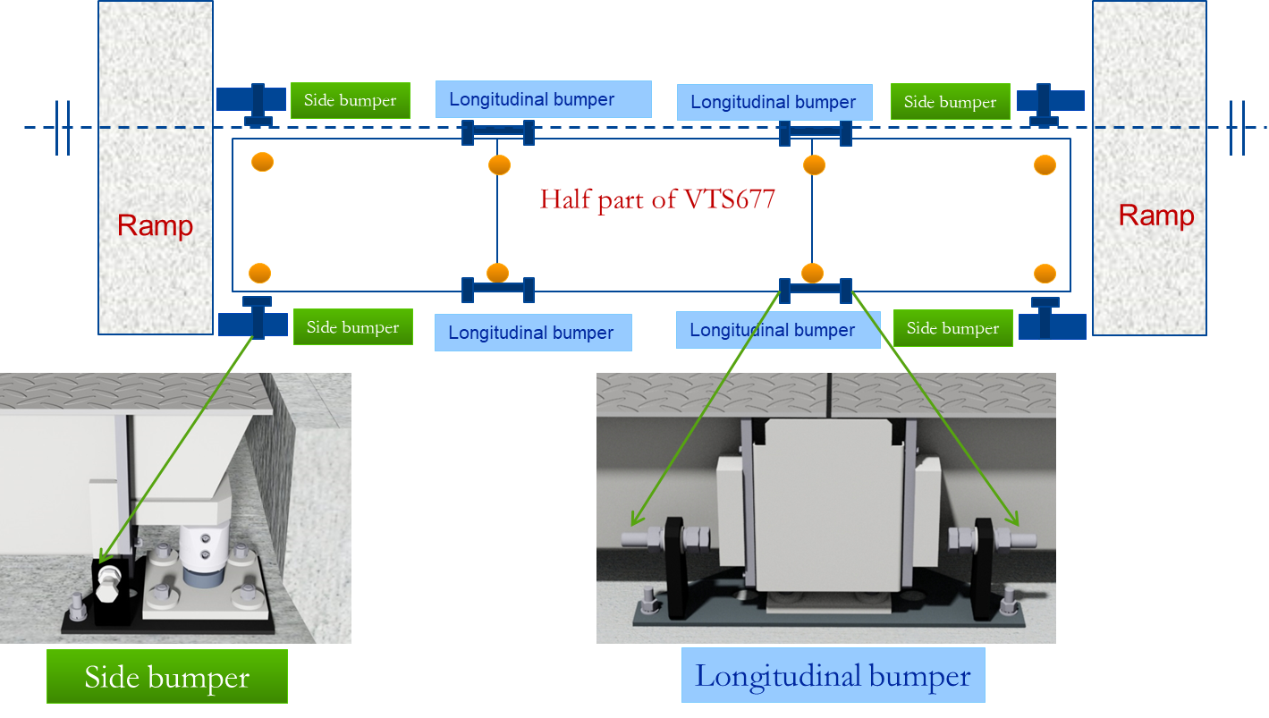
Value Proposition #3
Feature: Mid-bumper design
Advantage: Anti Thermal expansion and contraction design
Benefit: Easy for maintenance in customer side
Value Proposition: Help customer to avoid maintenance time
Value Message: Free maintenance

